Slide 1
A Brief intro to NER in Biomedical Domain
Subtitle

Slide 2
Issues in BIO domain
Large multi span mentions in documents
Similar surface names in knowledge base
Jargons and abreviations
Zero shot learning issues

Slide 3
Leading to these scenarios
One to many mapping of mention to target entity
Word itself might be ambiguos in meaning to perform maping
Tagging the mention (BIO)
Zero shot measures (covid-19)
No semantic hierarchy is available (semantic mismatch)

Slide 4
Examples
similar surface forms, making the disambiguation task difficult For example, Pseudomonas aeruginosa is a kind of bacteria, while Pseudomonas aeruginosa infection is a disease. Many existing biomedical information extraction tools rely on similarities in surface forms of mentions and candidates, and thus invariably falter in more challenging cases such as these.

Slide 5
Additionally, long mention spans (e.g., disease names and the density of mentions per document make the biomedical entity linking very challenging.

Slide 6
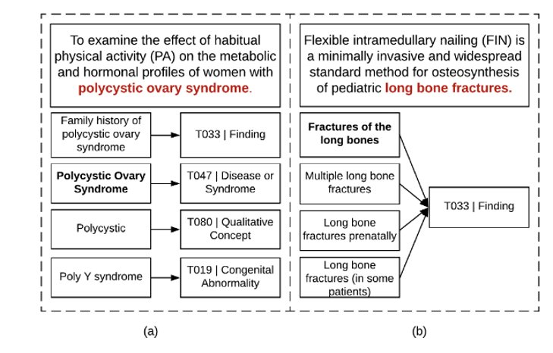
Latent Semantic types

Slide 7
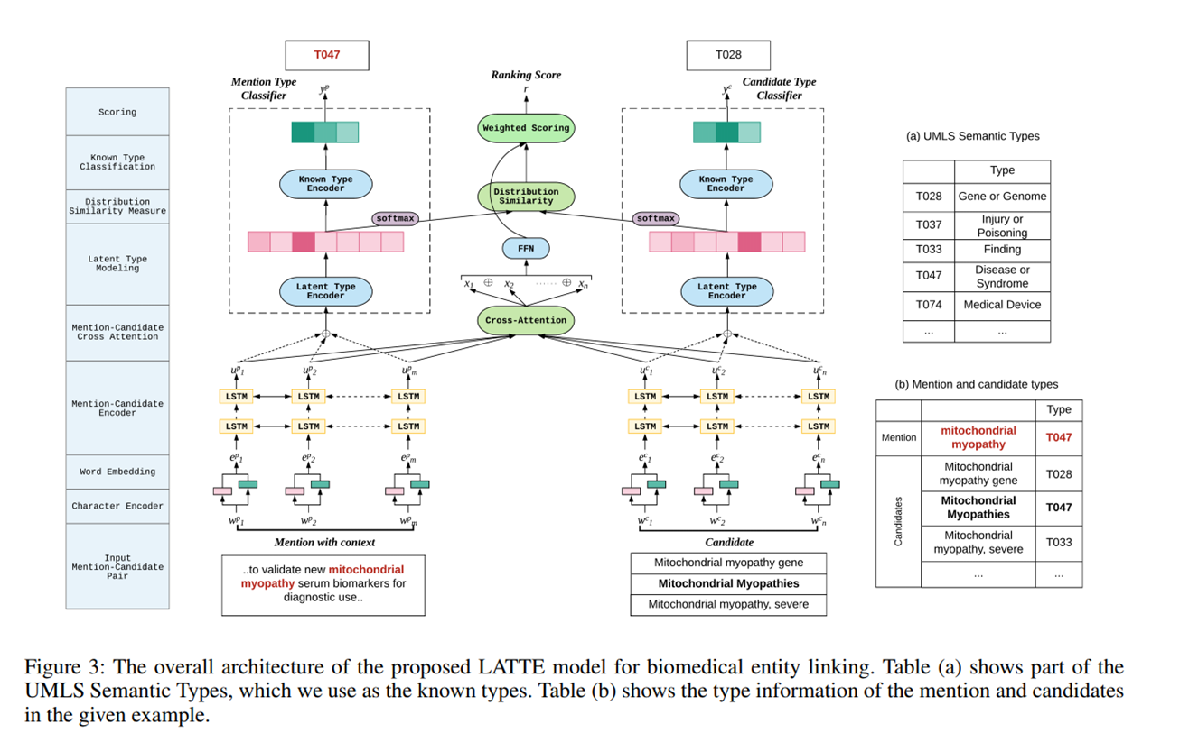
Latte model

Slide 8
BIOEL rerank paradigm
This fine grained type information is not always available.
The types that are available are coarse grained. For ex :
–"Type 2 Diabetes Mellitus" and "Parkinson Disease" both have the semantic type Disease or Syndrome ( T-047 )
–But the former is a metabolic disorder , while the latter is a nervous system disorder.
–So, Here a fine grain typing could be based on the body system where the disease occur.

Slide 9
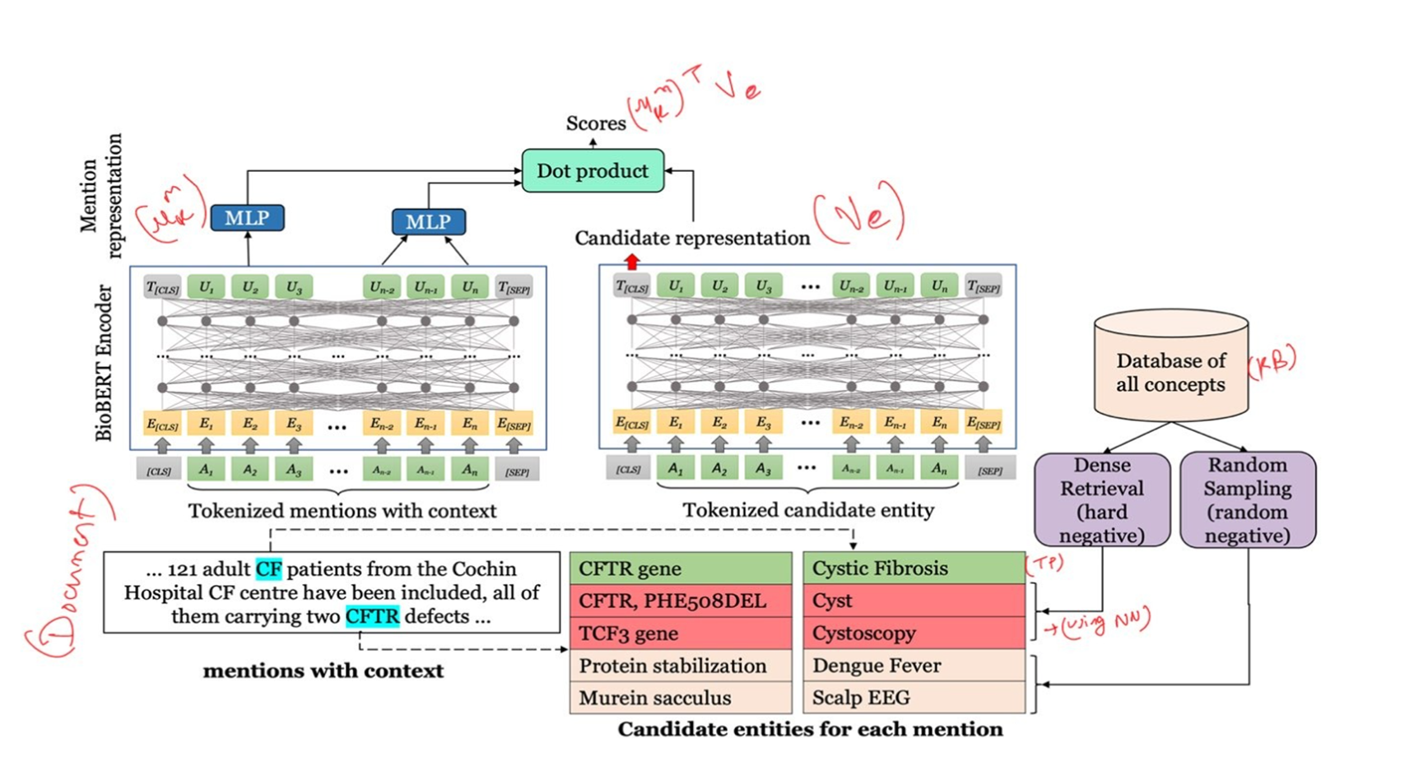
Dual Encoder model

Slide 10
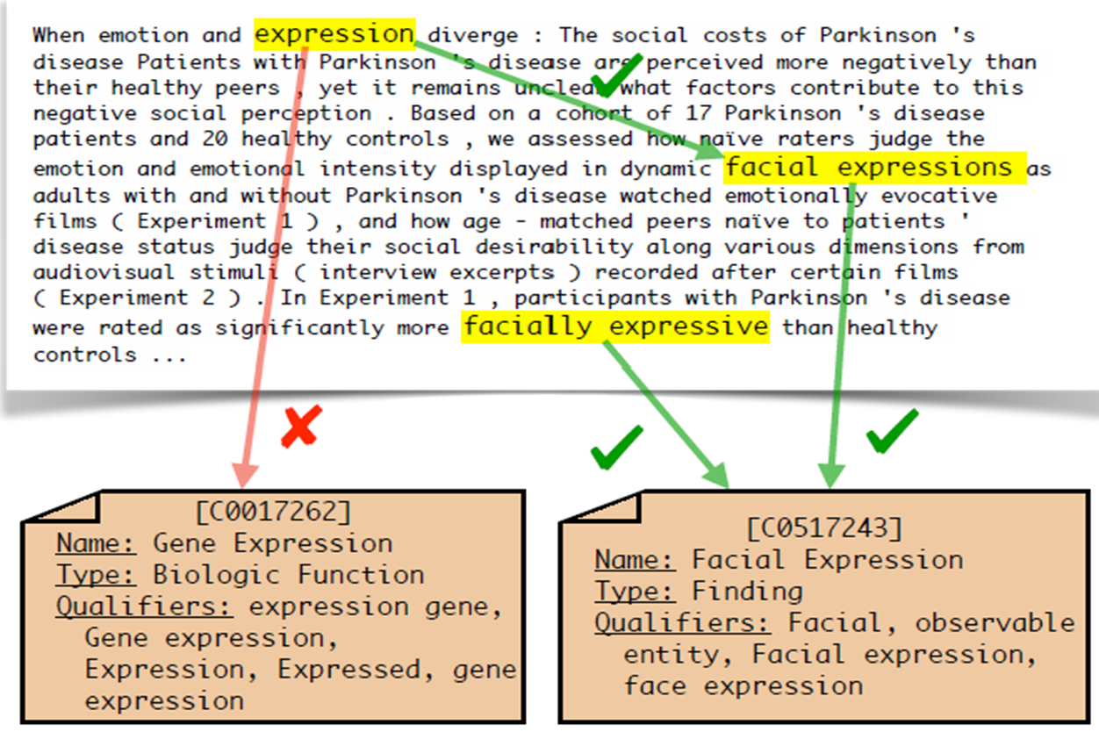
clustering

Slide 11
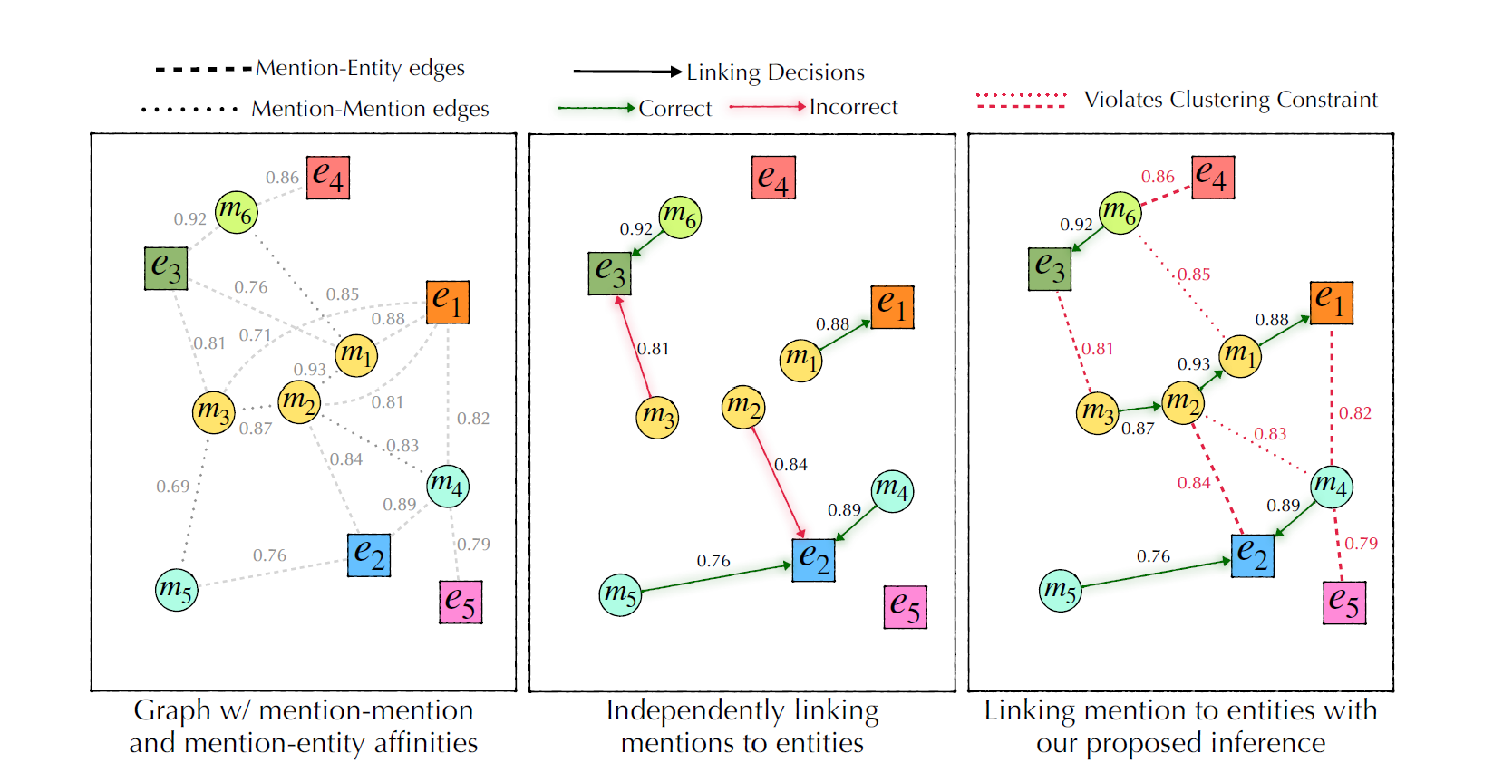
clustering

